Slide 1
COVID-19 MASK DETECTION
USING DEEP LEARNING
By
-Dinahar M(211417104053)
-Anirudh Subramanyam(211417104068)
-GG Gokelnath(211417104018)
Project Guide :
Mr. M Mohan

Slide 2
INTRODUCTION
The alarming COVID-19 pandemic is still affecting millions, making mandatory for mask regulation in all cities by the Government of India. Therefore, it is crucial to improve the recognition system to improve the performance of the existing facial recognition system immediately.
There are no publicly available masked face recognition datasets.To this end, this work proposes three types of masked face datasets, including Masked Face Detection
Dataset (MFDD), Real-world Masked Face Recognition Dataset (RMFRD) and Simulated Masked Face Recognition Dataset (SMFRD).
We’ll be using RMFRD because it is the world’s largest masked face dataset.

Slide 3
LITERATURE SURVEY
On December 31st 2019, China notified the outbreak to the World Health Organization
and on 1st January the Huanan seafood market was closed. On 7th January the virus was
identified as a coronavirus that had >95% homology with the bat coronavirus and > 70%
similarity with the SARS CoV. Environmental samples from the Huanan seafood market also
tested positive, signifying that the virus originated from there, . The number of cases
started increasing exponentially, some of which did not have exposure to the live animal market, suggestive of the fact that human-to-human transmission was occurring.
The first fatal case was reported on 11th Jan 2020. The massive migration of Chinese during
the Chinese New Year fuelled the epidemic. Cases in other provinces of China, other countries
(Thailand, Japan and South Korea in quick succession) were reported in people who were returning from Wuhan.

Slide 4
Problem statement
> Increase the standards of safety to better reduce the spread of COVID
>Take preventive measures by staffing security based face-detection equipment to caution users that they’ll face action if they don’t wear a mask
>prepare for further waves

Slide 5
TECHNOLOGY STACK
Existing System:
• Support Vector Machine
• Discrete Wavelet Transform
Proposed System:
• Convolution Neural Network(CNN)
• Caffe Models
Software Required:
Python Idle
Library Packages

Slide 6
SYSTEM ARCHITECTURE
Input
Pre-processing
Cropping Face image
Database
Caffe mobile set models
CNN classification
With Mask
Without mask

Slide 7
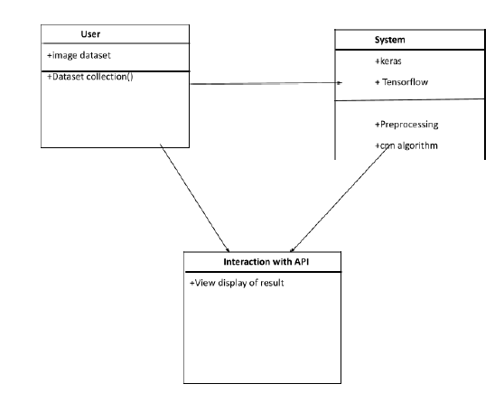
CLASS DIAGRAM

Slide 8
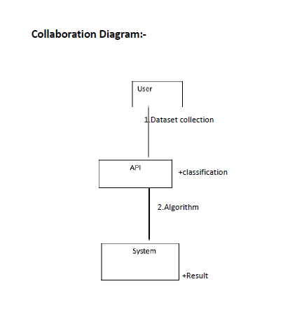
COLLABORATION
DIAGRAM

Slide 9
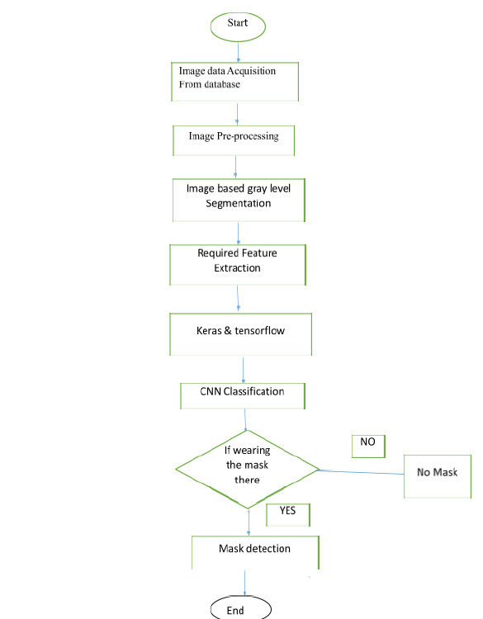
FLOW CHART

Slide 10
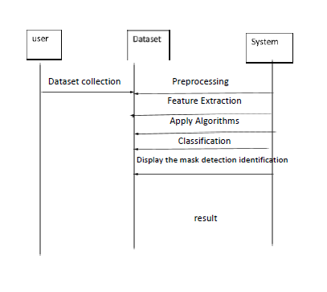
SEQUENCE DIAGRAM

Slide 11
MODULES
•Preprocessing
•Feature Extraction
•Neural Network
•SMTP

Slide 12
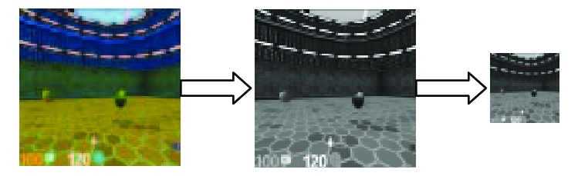
PREPROCESSING
•Preprocessing is the data preprocessing and data augmentation module of the Keras deep learning library. It provides utilities for working with image data, text data, and sequence data

Slide 13
Feature extraction:
This describes the relevant shape information contained in a pattern so that the task of classifying the pattern is made easy by a formal procedure. In pattern recognition and in image processing, feature extraction is a special form of dimensionality reduction.

Slide 14
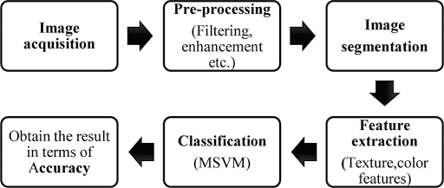

Slide 15
Neural Network:
•A neural network is a series of algorithms that endeavors to recognize underlying relationships in a set of data through a process that mimics the way the human brain operates. In this sense, neural networks refer to systems of neurons, either organic or artificial in nature

Slide 16
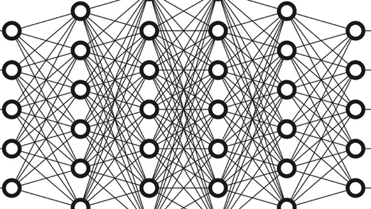
X
X+4
X+(X+4)+....
2
……...
1
3
n
A
A
B
A
A
A
A
A
A
B
A
A
A
A
A
c
A
A
A
A
A
d
A
A
A
A
A
E
A
A
A
A
A

Slide 17
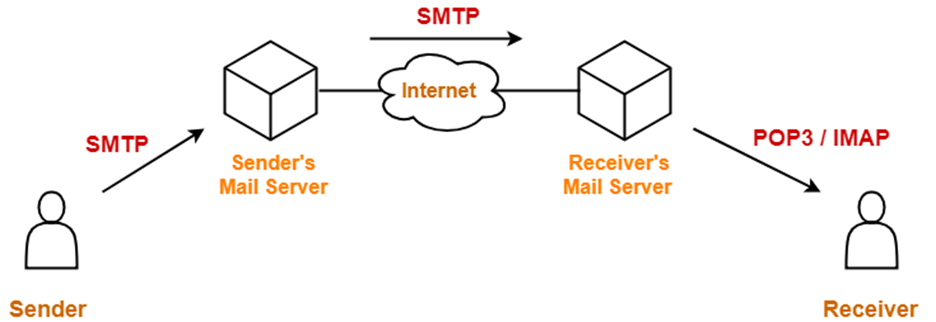
SMTP
•To send an alert with an attachment towards any of the authority in the case of when a person doesn’t wear a mask.

Slide 18
Testing
Testing the code initially provided unstable and irregular results. However as there were more training with multiple simulated and real world masked face data sets, the machine learning algorithm could effectively capture the situational case of a mask being present on the face or not.
The algorithm was fine tuned to identify the subject in the image much faster after being repeatedly exposed to real world face face data as opposed to simulated/cg data.

Slide 19
results
We were able to generate accurate face masks for human objects from RGB channel images containing localized objects.
We demonstrated our results on a Multi-Human Parsing Dataset with mean pixel level accuracy.
The problem of erroneous predictions has been solved and a proper bounding box has been drawn around the segmented region.

Slide 20
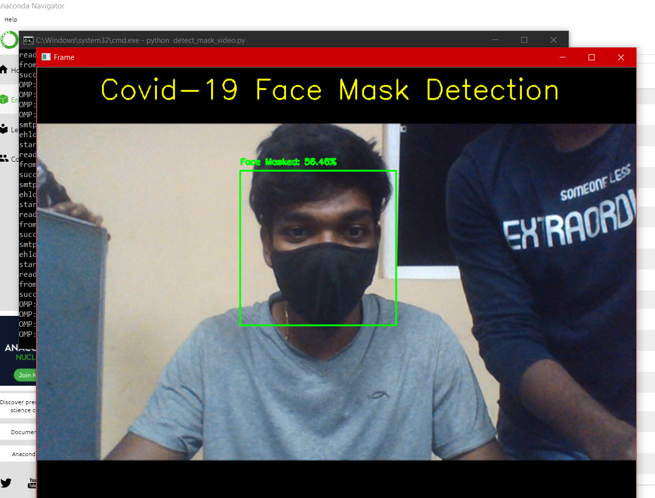
screenshots

Slide 21
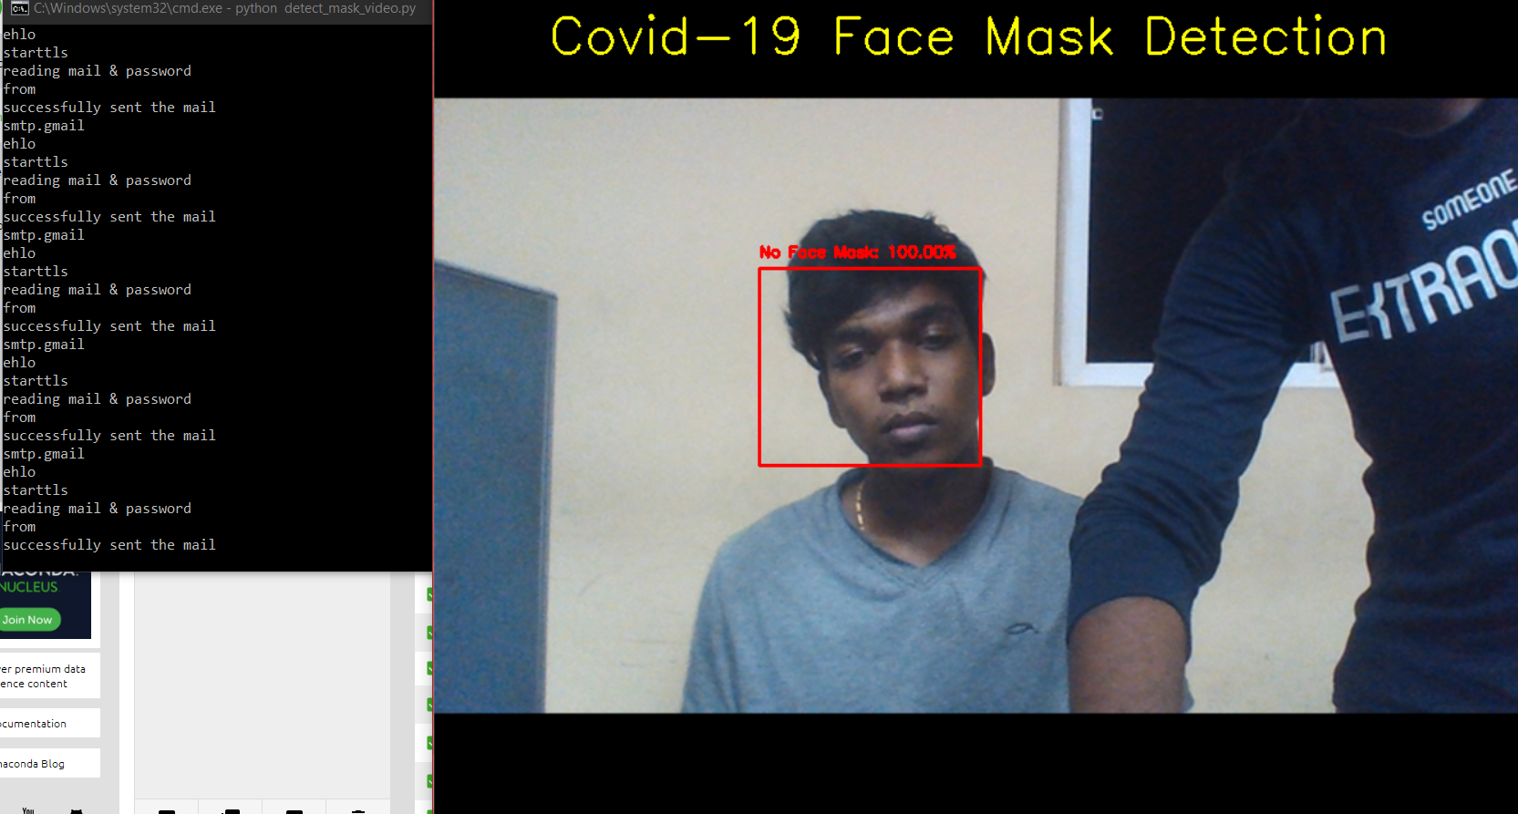
screenshots

Slide 22
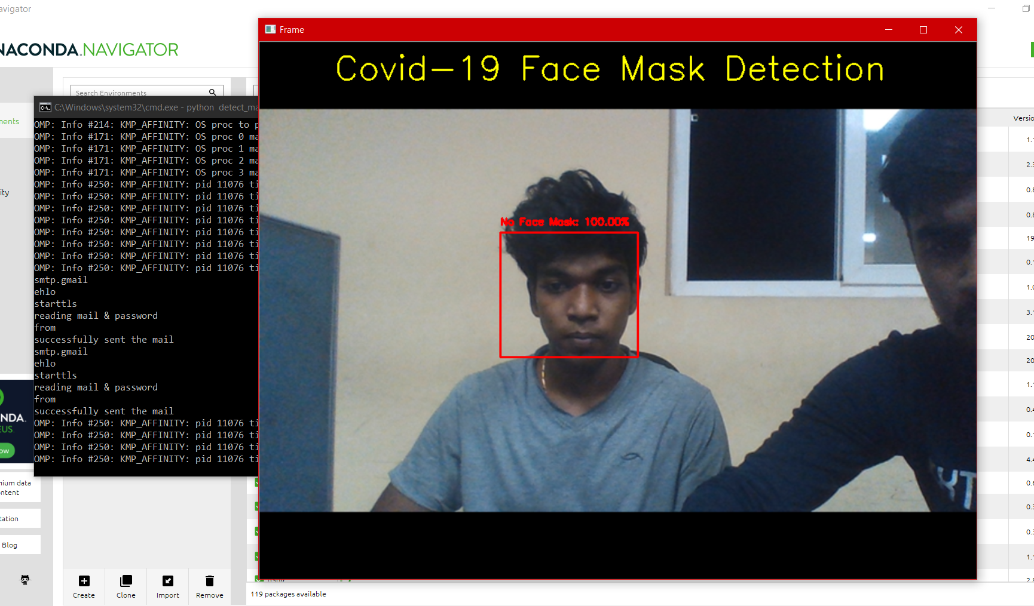
screenshots

Slide 23
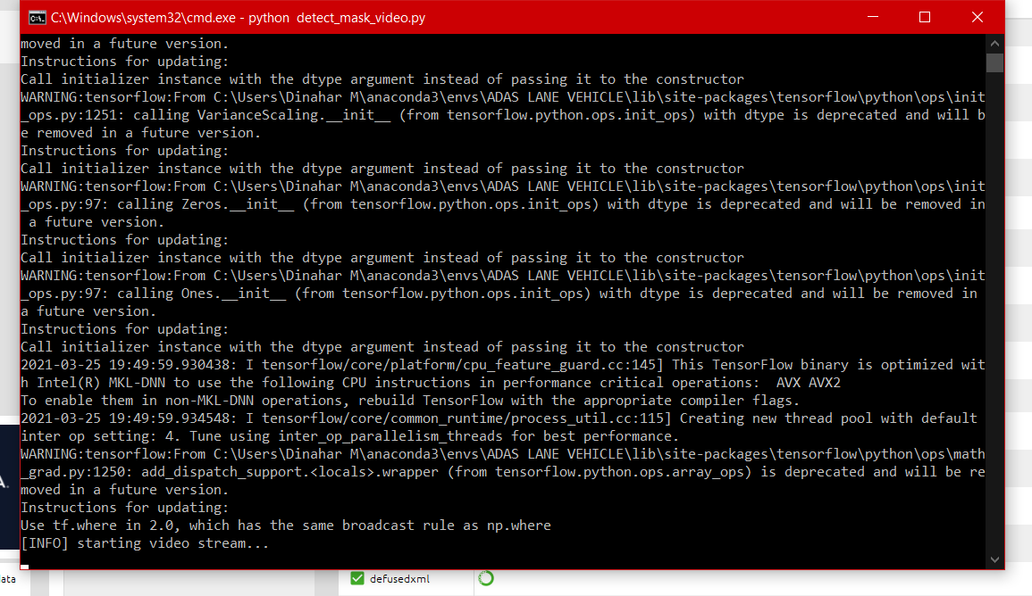
screenshots

Slide 24
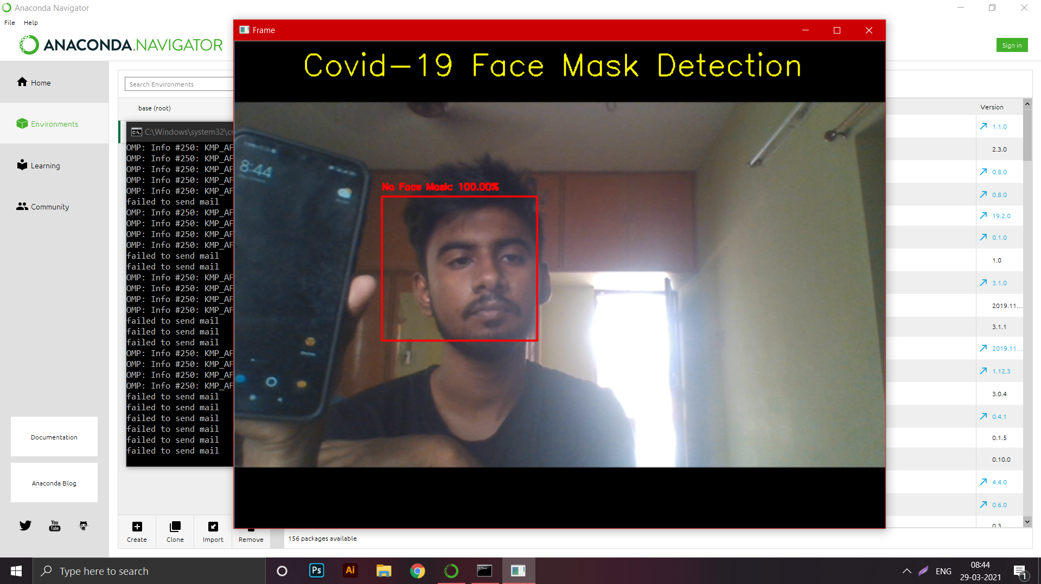
screenshots

Slide 25
conclusion
The project works successfully for its intended purpose. However, there are a number of aspects we plan to work on shortly:
∙Currently, the model gives 5 FPS inference speed on a CPU. In the future, we plan to
improve this up to 15 FPS, making our solution deployable for CCTV cameras,
without the need of a GPU. The use of Machine Learning in the field of mobile deployment is rising rapidly. Hence, we plan to port our models to their respective TensorFlow Lite versions. Our architecture can be made compatible with TensorFlow RunTime (TFRT), which will increase the inference performance on edge devices and make our models efficient on multithreading CPUs

Slide 26
references
1. P. Viola and M. J. Jones, “Robust real-time face detection,” Int. J. Comput. Vision,
vol. 57, no. 2, pp. 137–154, May 2014.
2.P. Viola and M. Jones, “Rapid object detection using a boosted cascade of simple
features,” in Proceedings of the 2001 IEEE Computer Society Conference on
Computer Vision and Pattern Recognition. CVPR 2001, vol. 1, Dec 2016, pp. I–I.
3. J. Li, J. Zhao, Y. Wei, C. Lang, Y. Li, and J. Feng, “Towards real world human
parsing: Multiple-human parsing in the wild,” CoRR, vol. abs/1705.07206.
4. A. Krizhevsky, I. Sutskever, and G. E. Hinton, “Imagenet classification with deep
convolutional neural networks,” in Advances in Neural Information Processing
Systems 25, F. Pereira, C. J. C. Burges, L. Bottou, and K. Q. Weinberger, Eds. Curran
Associates, Inc., 2016, pp. 1097–1105.
5. K. Simonyan and A. Zisserman, “Very deep convolutional networks for large-scale
image recognition,” CoRR, vol. abs/1409.1556, 2017.
6. C. Szegedy, W. Liu, Y. Jia, P. Sermanet, S. Reed, D. Anguelov, D. Erhan, V.
Vanhoucke, and A. Rabinovich, “Going deeper with convolutions,” 2015.
7. K. He, X. Zhang, S. Ren, and J. Sun, “Deep residual learning for image
recognition,” 2016 IEEE Conference on Computer Vision and Pattern Recognition
(CVPR), pp. 770–778, 2016. [10] K. Li, G. Ding, and H. Wang, “L-fcn: A lightweight
fully convolutional network for biomedical semantic segmentation,” in 2018 IEEE
International Conference on Bioinformatics and Biomedicine (BIBM), Dec 2018, pp.
2363–2367.

